Slide 1
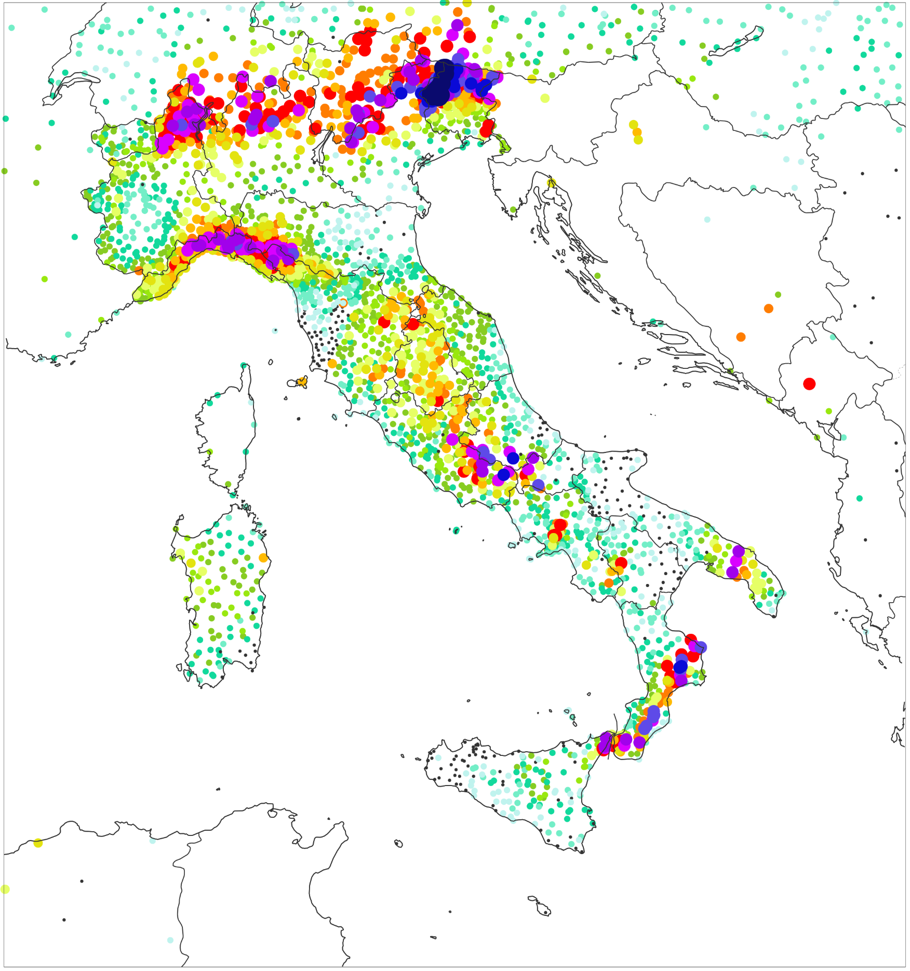
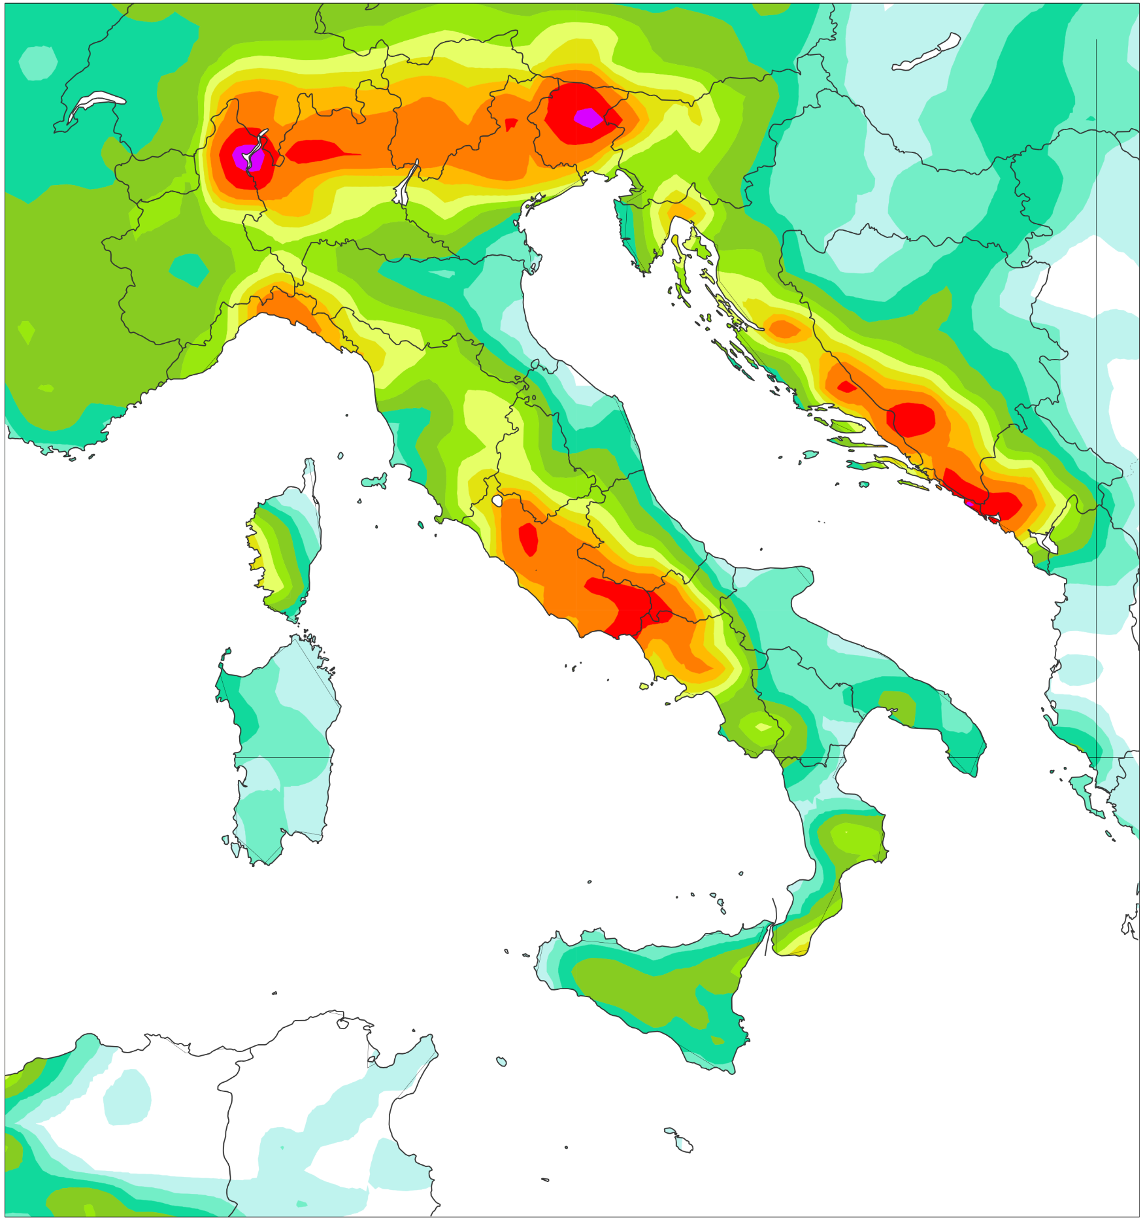
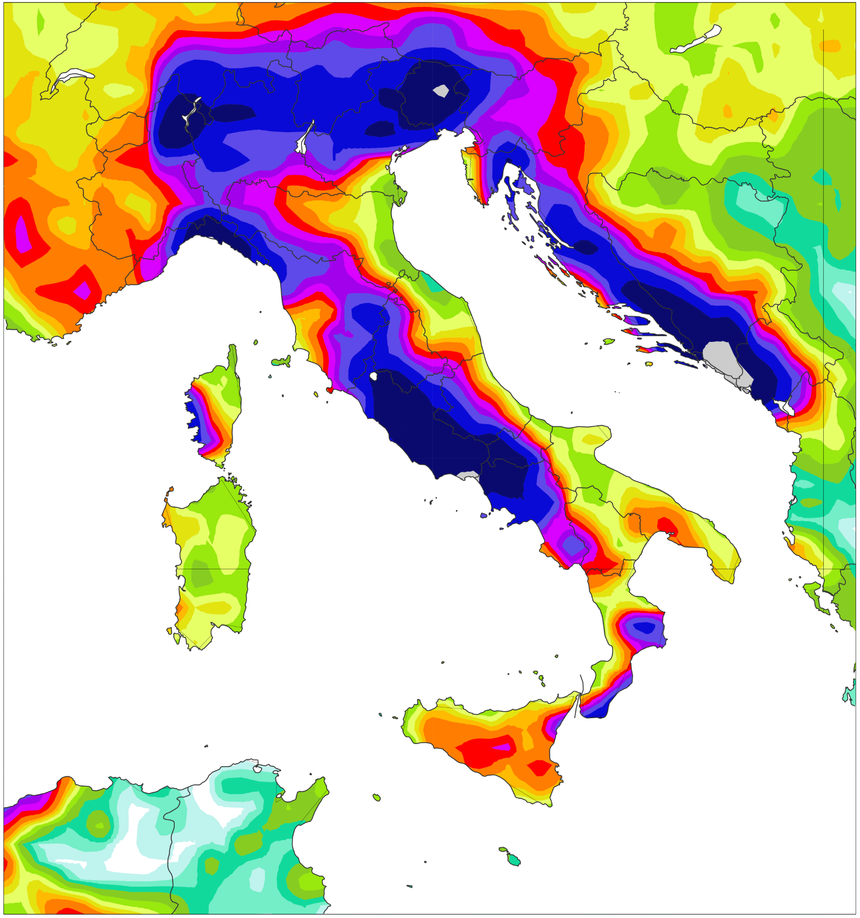
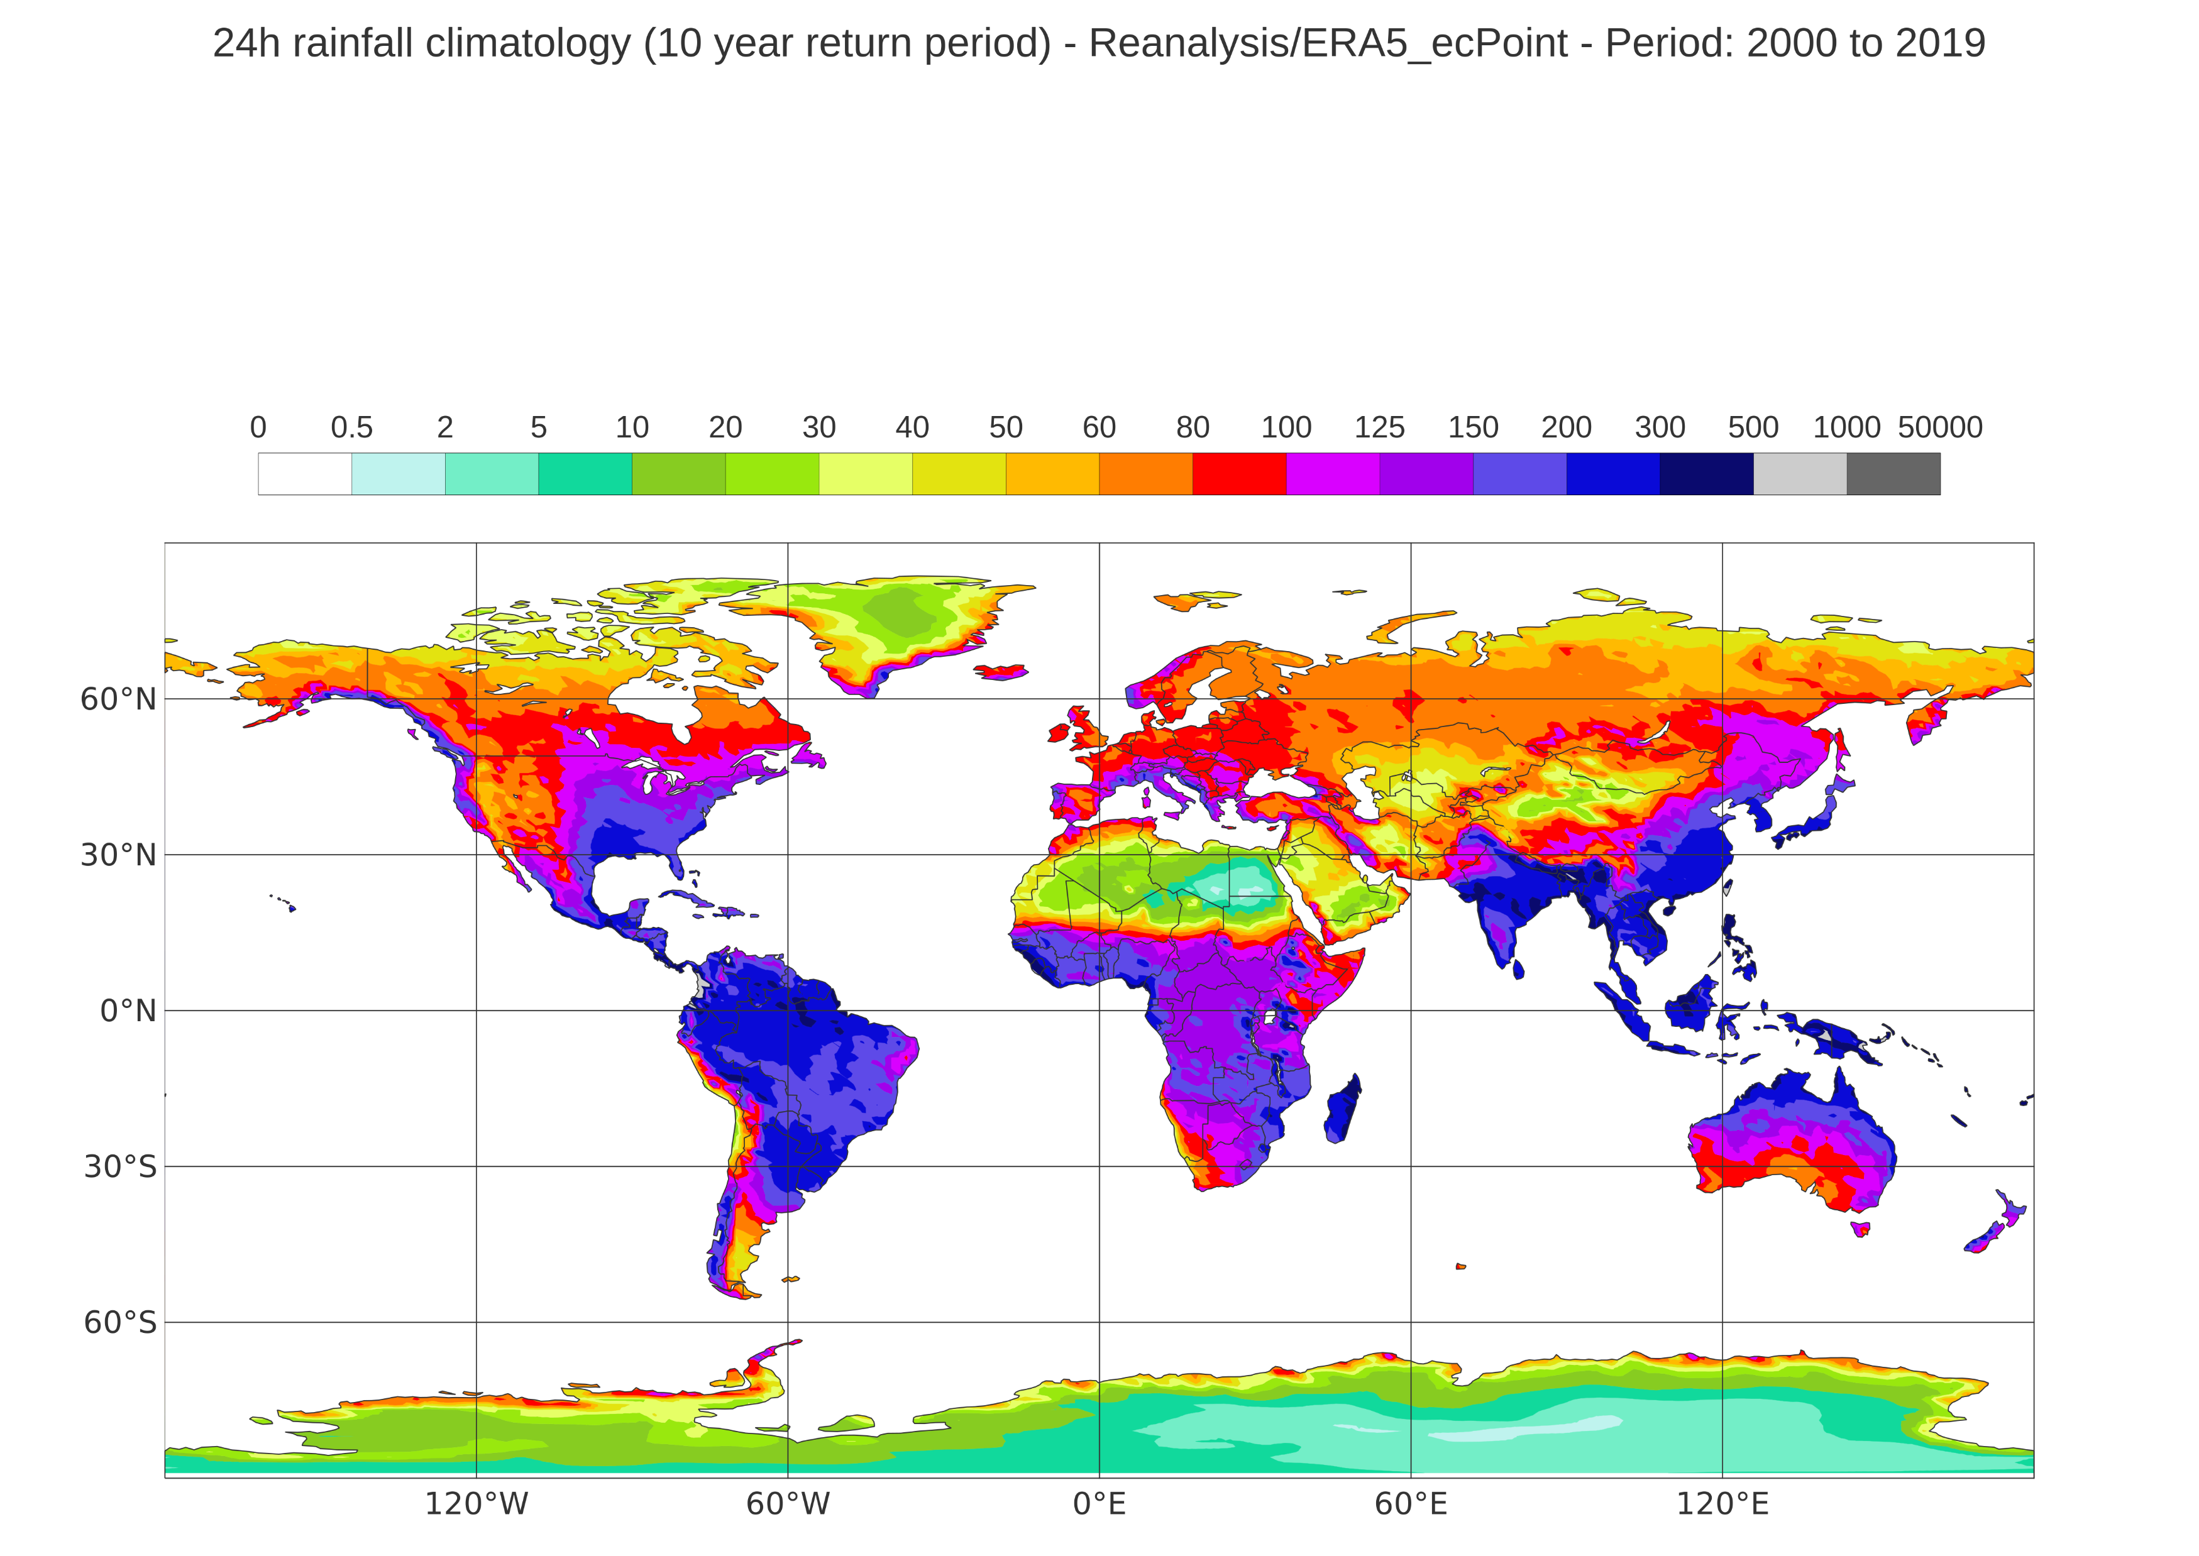
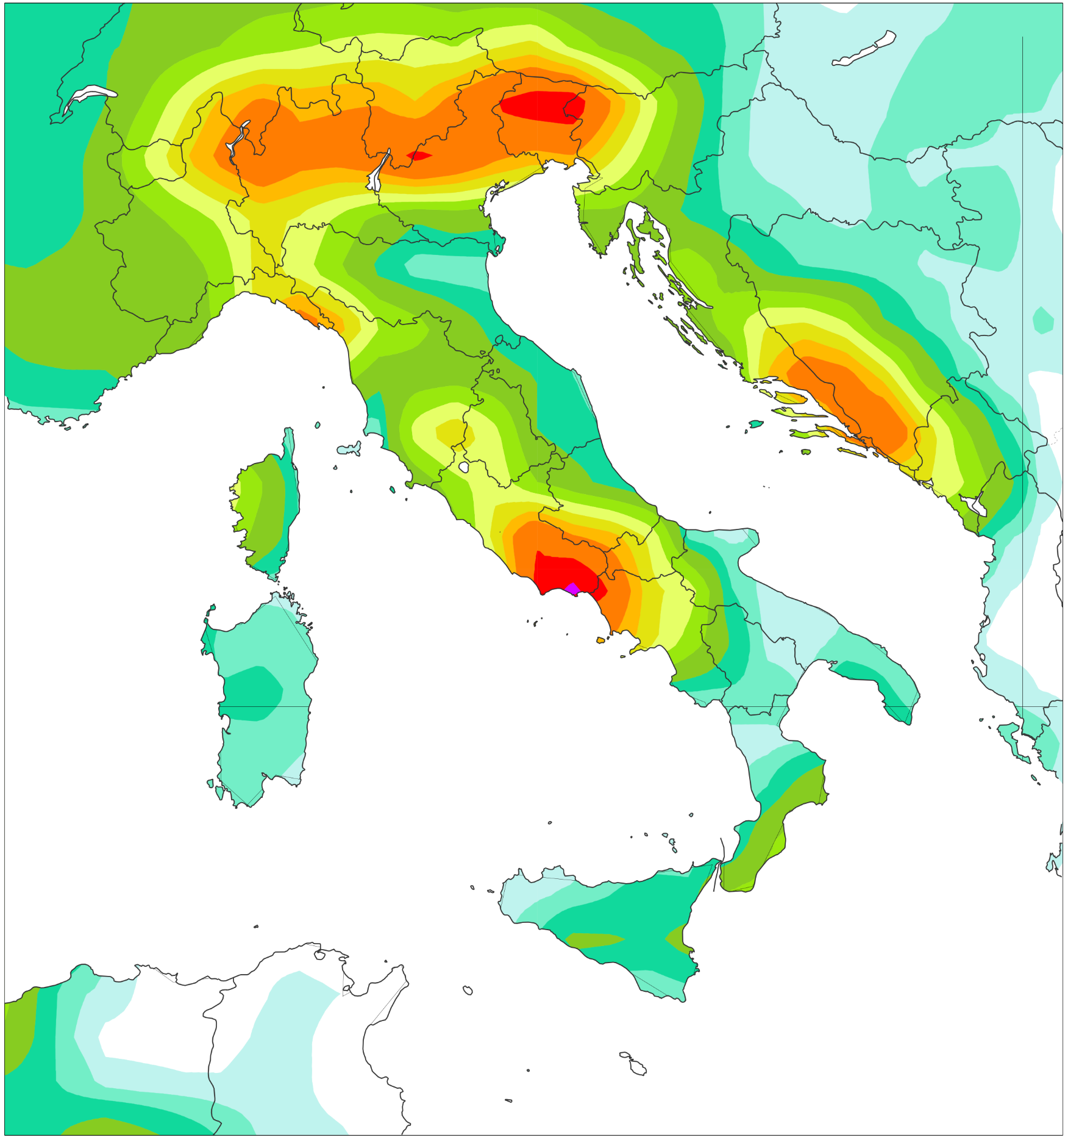
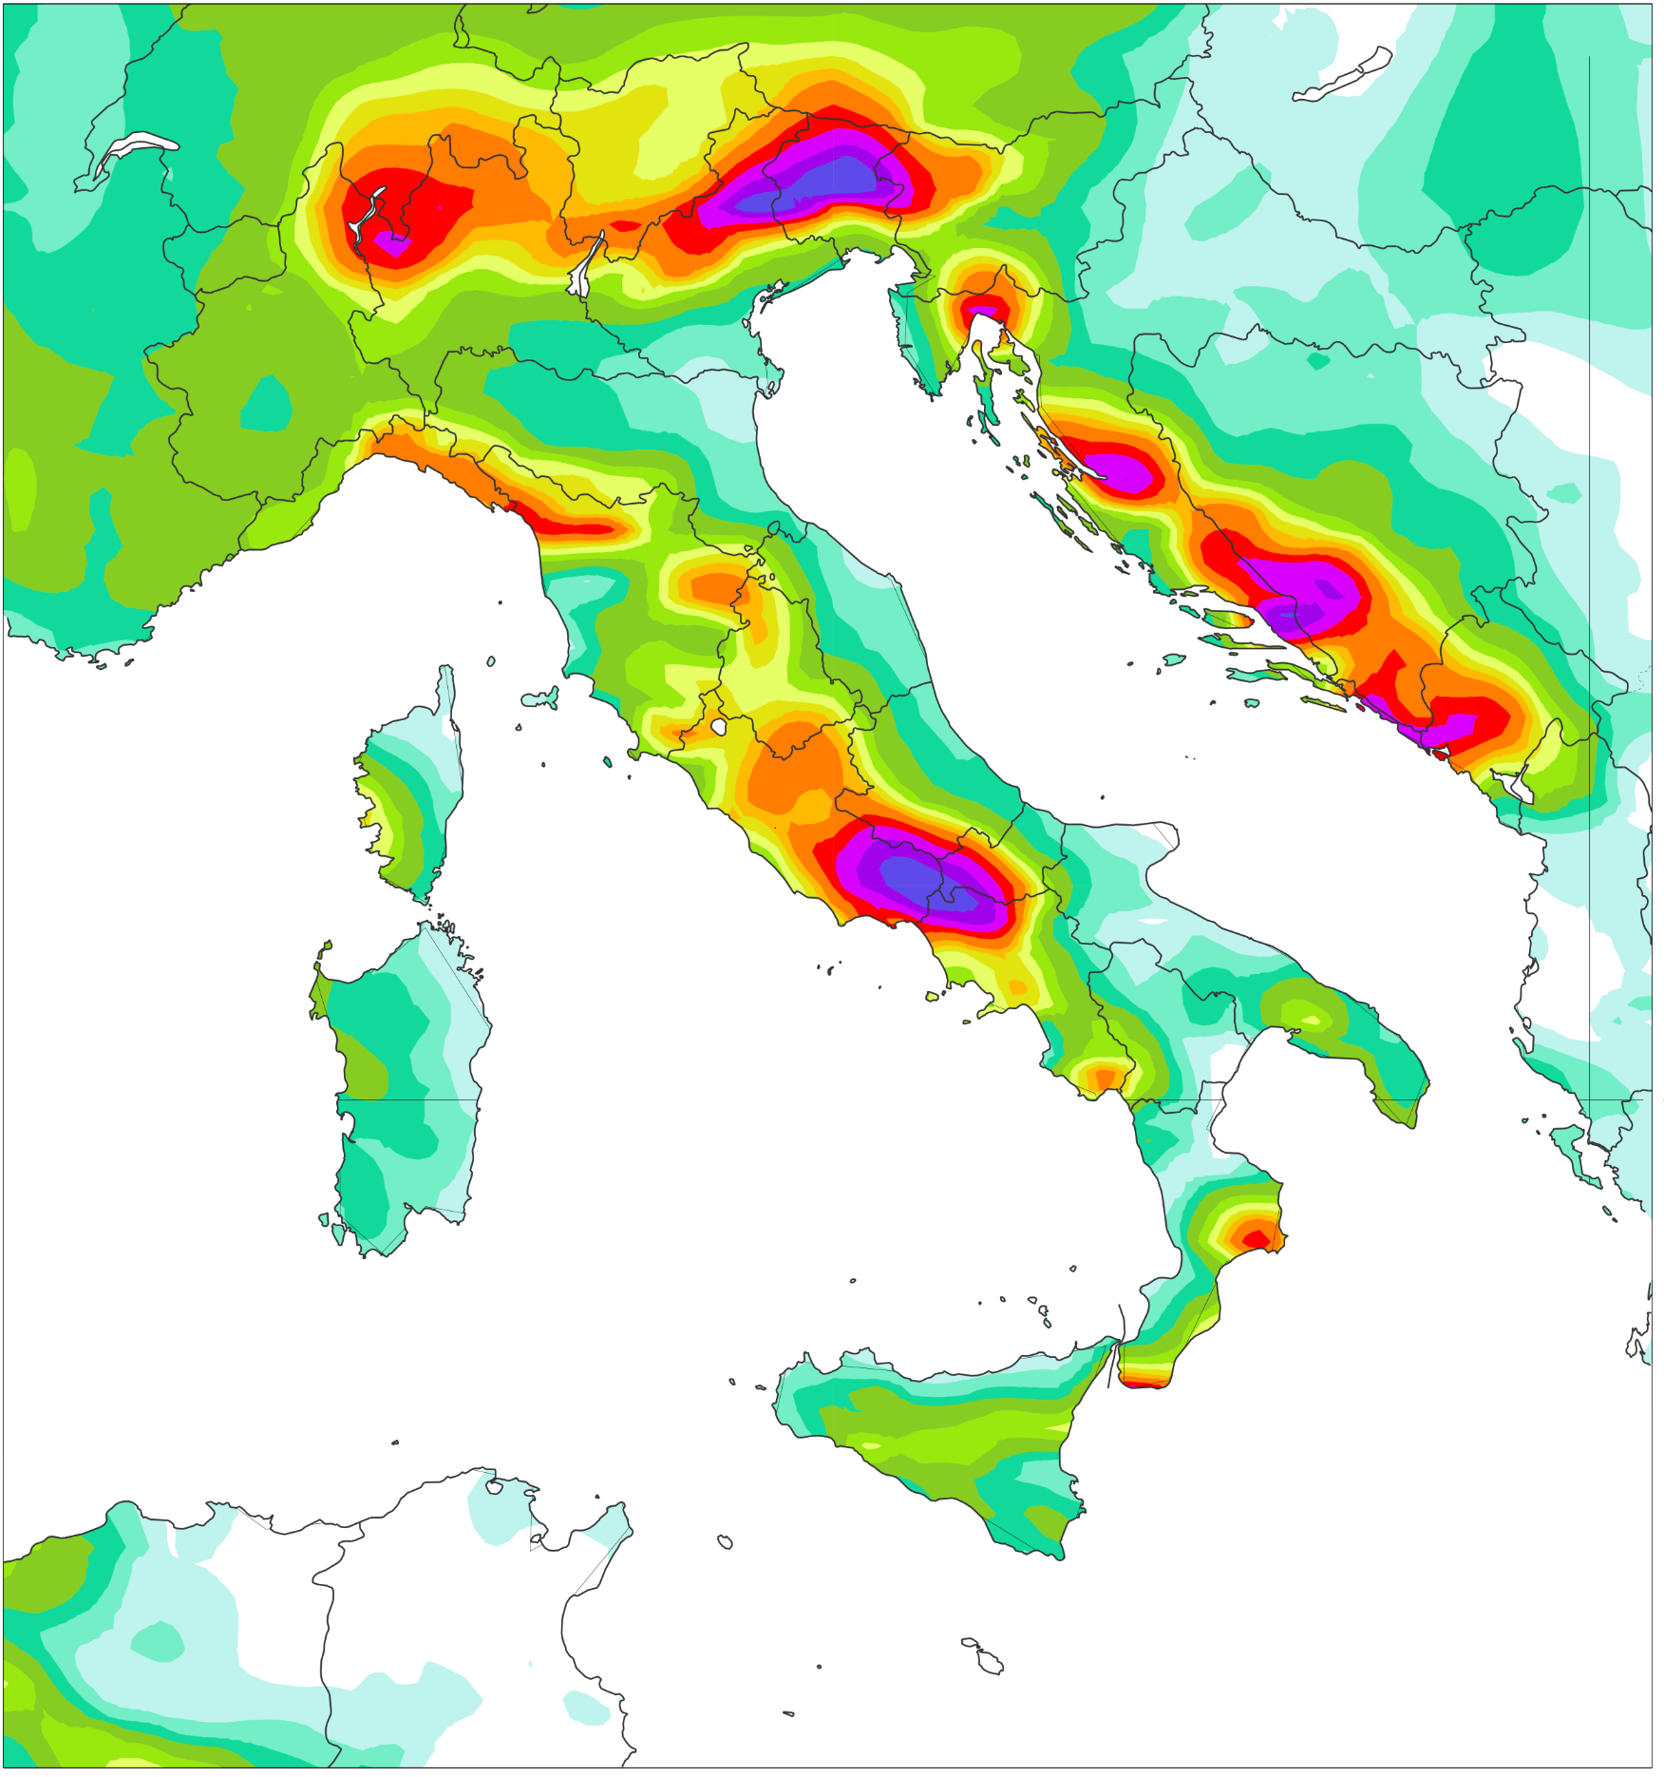
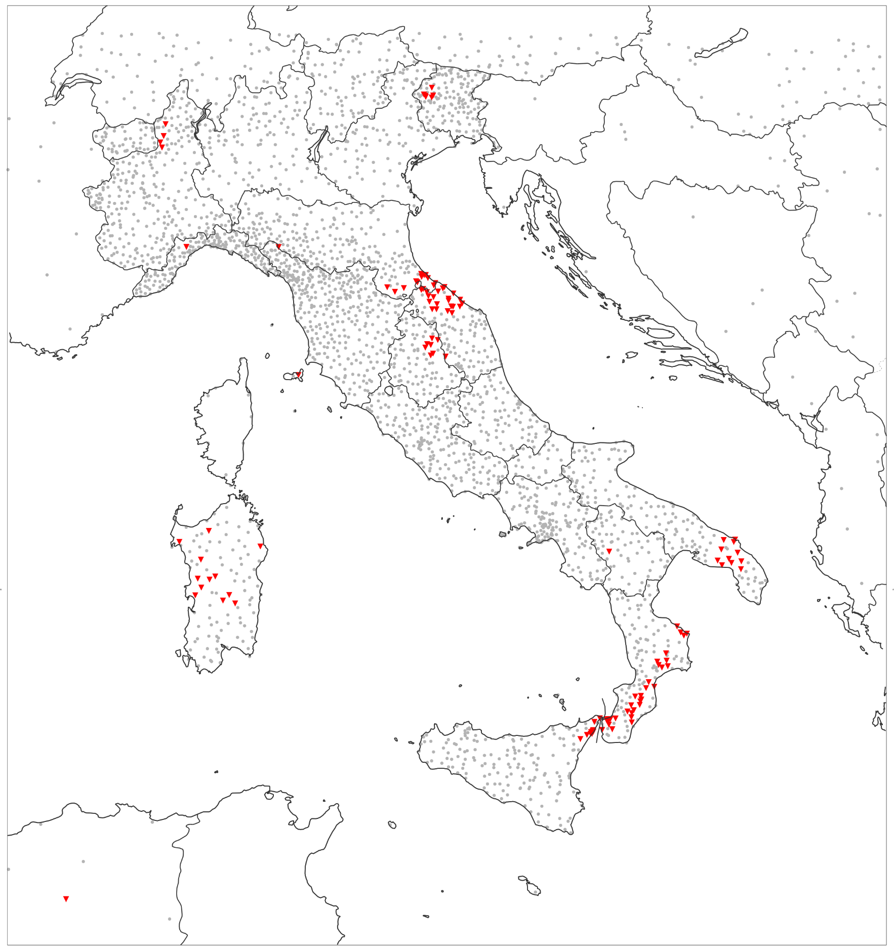
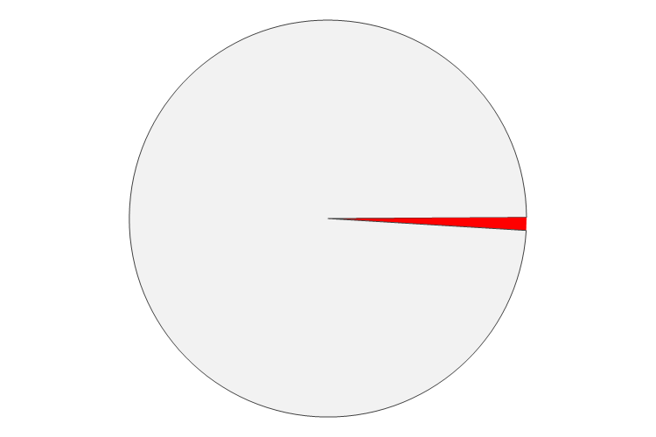

24-hourly total precipitation [mm/24h] for widespread flash floods in Italy (Storm Vaia)
Valued valid between 28th October 2018 at 00 UTC and 29th October 2018 at 00 UTC
mm/24h
(c) ERA5 (31 km)
Deterministic
(e) ERA5 – ecPoint (Point-scale )
99th percentile - Probabilistic
inf
(a) Gauge observations (Point-scale)
1000
500
300
200
150
125
100
80
(b) ERA5 – EDA (62 km)
Control Run - Deterministic
(d) ECMWF Reforecasts - 46r1 (18km)
Control Run, Day 1 - Deterministic
(f) Observations exceeding ERA5-ePoint estimates at 99th percentile
60
50
0.96%
40
Northern
Italy
30
20
10
5
6.27%
2
Central + Southern
Italy
0.5

